Slide 1
Nasonex® Direct-to-Consumer TV Advertising:
Summary of Sales Impact & Return-on-Investment Evaluation
Promotion Response Analytics
Commercial Analytics
US Commercial Operations
February 2nd, 2012

Slide 2
ROI Analysis Results
This analysis suggests that investments in Nasonex® TV media, production, talent and agency fees were profitable during the studied time period (August 2009 through July 2011) with an ROI of 2.7:1.
  Approximate incremental revenue (3-year net present value) is $2.7 per dollar spent.
  All values in this presentation are expressed on a pre-tax basis.
Several conclusions of the analysis provide evidence in support of additional investment in Nasonex® TV media in 2012.
  An increase in media investment of approximately $5MM vs. historical investments is expected to result in an increase in profit from the investment of about $8.5MM.
  The second half of the year is more impactful per ad than the first half of the year.
  Within the experience range the response is linear and does not show saturation.
    Incremental dollars invested would be expected to result in incremental revenue similar to that achieved historically (depending on the semester in which these are invested) until the total investment reaches approximately $60MM per year. $60MM is the high end of the experience range, and point of saturation lies somewhere above this value.
  During the study period, annual spend was about $42.2 MM. About $26 MM of this spend generated as much business as was taken away by OTC TV advertisements during the year.
  Increasing the second semester spend by $1MM is highly likely to result in an incremental $3.6MM of 3-year net present value.
    This is a conservative estimate based on the smallest likely impact and is the lower bound of the expected impact.
    Modeling results suggest that additional revenue as high as $5.9MM per $1MM invested in the second semester may be achievable.

Slide 3
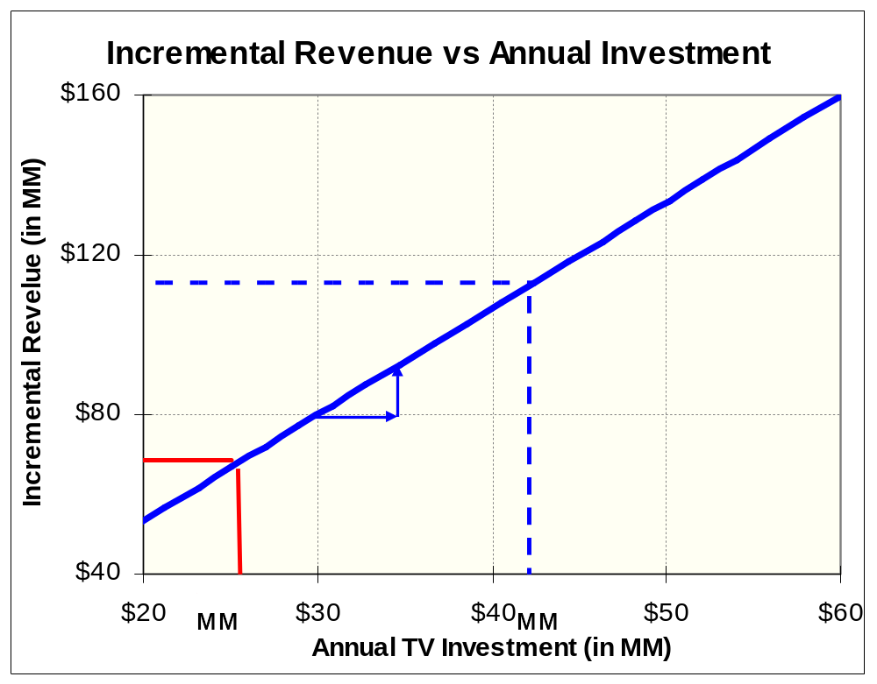
Incremental Revenue by Total pre-tax Investment
This incremental revenue vs. pre-tax annual DTC TV spend chart shows that within experience range the response is linear and does not show saturation.
Historical annual TV investment is about $42.2 MM. This generated a 3-year pre-tax incremental revenue of about $112 MM .
An increase of $5 MM in investment would result in an additional incremental revenue of about $13 MM ($8.5MM Profit)
Red line represents the revenue lost to OTC TV Ads.
OTC Ads resulted in a loss of $68MM in revenue. About $26MM of Annual TV Investment is required to negate the impact of OTC TV Ads on Nasonex NRx.
After Allegra OTC launch in March 2011, the TV spend for Allegra OTC has increased drastically, hence moving forward, a higher negative impact of OTC TV ads may be observed.
Study Period: Aug-2009 to Jul-2011

Slide 4
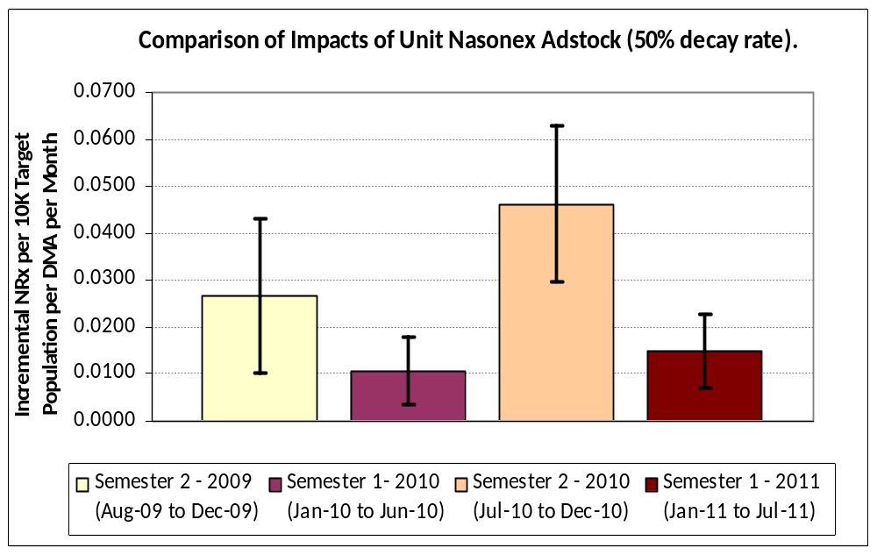
TV Campaign Impacts across Semesters
Per :60 second GRP Adstock, First half of 2011 was as effective as that of 2010. Also, per Adstock, Semester 2’s are more responsive than Semester 1.
Second half of the years (Semester 2’s) are more responsive per GRP Adstock than First half of the years (Semester 1’s).
First half of 2011 is as responsive (per weighted GRP Adstock) as Semester 1 of 2010 as their confidence intervals overlap.
This represents 95% confidence Interval. For first half of the year, both 2010 and 2011 estimates overlaps, suggesting that they are not different statistically.
Semester level estimates here were obtained from supporting models. They are more appropriate in making relative comparisons.
Study Period: Aug-2009 to Jul-2011

Slide 5
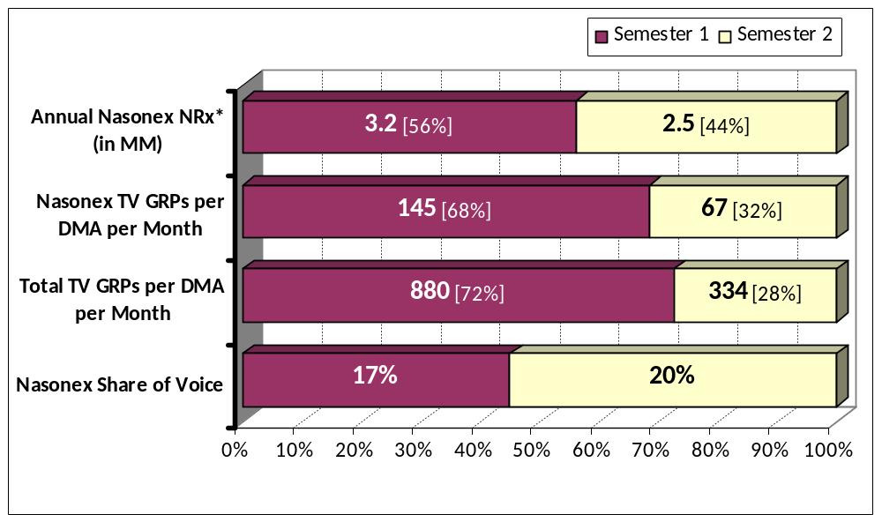
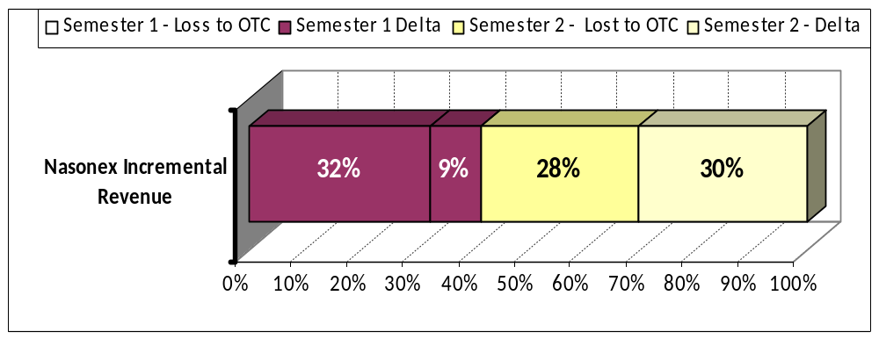
TV Campaign Trends: First and Second Semesters
Total TV Voice in Semester 2 is much lower than Semester 1. Semester 2 contributes about 59% of total 3 year pre-tax revenue generated.
About two-thirds of our annual spend was used during the first half of the year. This is much higher than the % of NRx’s generated during that period.
OTC competitors spent even more (~72%) of their annual spend during first half of the year.
During second half of the year, the total voice is relatively low, with less clutter for Nasonex® ads to break through.
A considerable portion of business is lost to OTC Ads. This loss is more during the Spring period.
Due to higher impact per Ad during the second half of the year, 59% of total incremental revenue comes from Ads during this period.
Increasing the spend in Fall would generate more incremental revenue.
Note: 28% loss to OTC during Semester 2 is most likely to be an under-estimate.
* Annual NRx in the chart is based on year 2010.
All other metrics are study period averages per DMA per Month
Study Period: Aug-2009 to Jul-2011

Slide 6
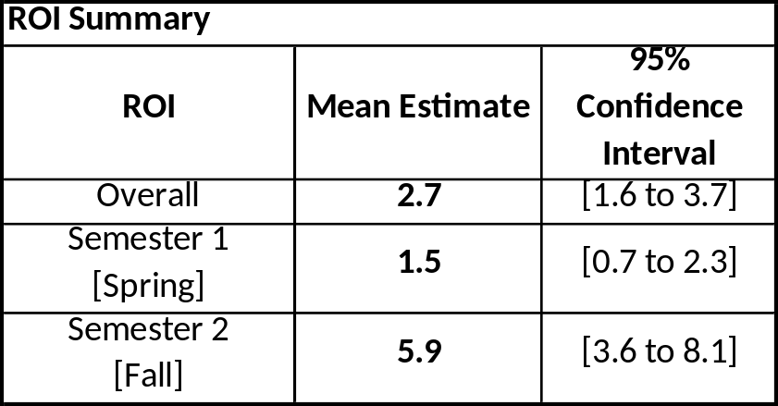
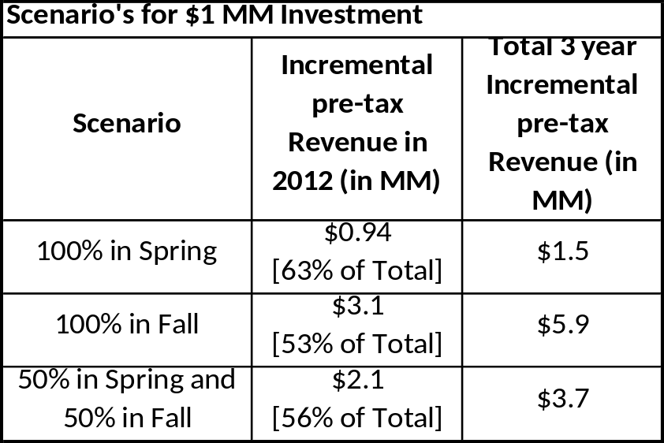
ROI by Semesters and 2012 Investment Returns
Semester 1 and Semester 2 ROI’s are approximately 1.5 and 5.9 respectively.
Spring investment would realize 63% of total incremental revenue in 2012. Fall investment would realize 53% of total incremental revenue in 2012.
Conservative Estimates of Total 3 year Incremental pre-tax Revenue due to $1 MM investment:
100% Spring Investment: $700 K.
100% Fall Investment: $3.6 MM
Study Period: Aug-2009 to Jul-2011

